Slide 1

Healthcare Provider Fraud Analysis
Terence Pak
03/23/2021

Slide 2

Analysis Background
Healthcare fraud is when a provider or consumer intentionally submits, or causes someone else to submit, false or misleading information for to alter the amount of health care benefits payable.
The National Heath Care Anti-Fraud Association estimates conservatively that health care fraud costs the nation about $68 billion annually, which shows just how important it is to uncover the fraud providers
Datasets include:
Inpatient/Outpatient Claims
Beneficiary Details

Slide 3
Data Assumptions
Alive patient age is the patient age as of the year 2009.
All providers have at least 1 beneficiary provide a claim. All beneficiaries have at least 1 provider.

Slide 4
Objectives
How can we predict what providers a potentially fraud provider?
What variables can we use to determine a potentially fraud provider?
What Machine Learning model has the best accuracy for prediction?
XGBoost
Random Forest
Logistic Regression
Decision Tree

Slide 5
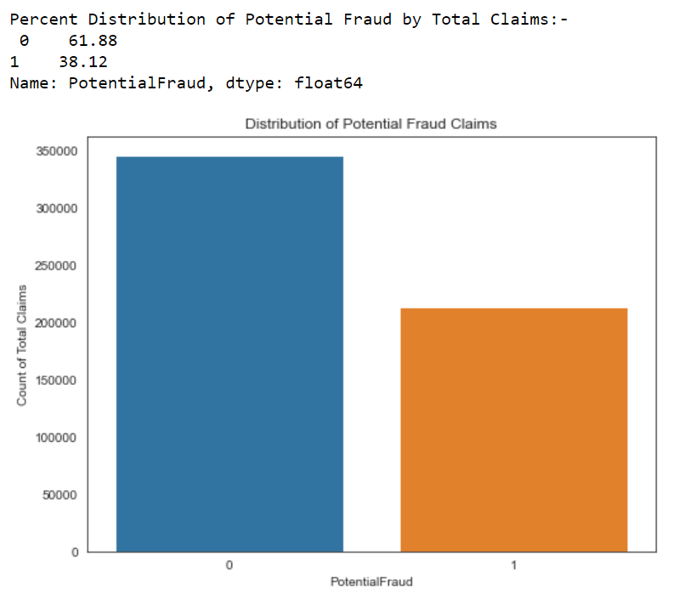
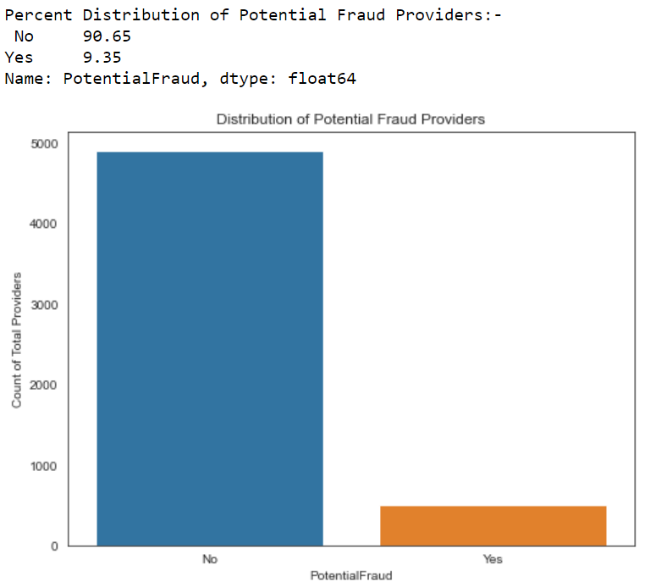
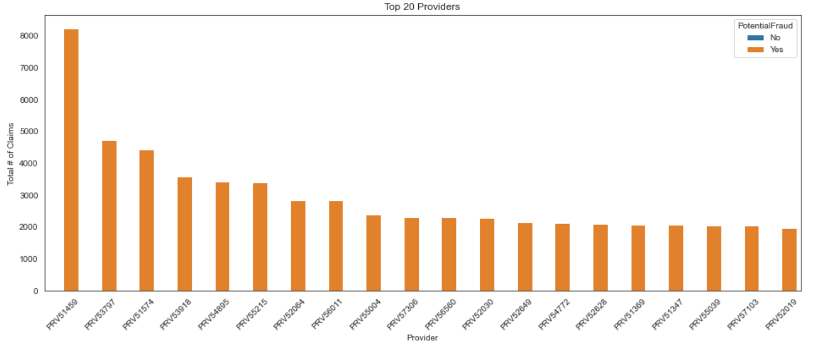
Potentially Fraud Claims Distribution
Over 38% of all claims are by potentially fraudulent providers, but only 9% of providers are potentially fraudulent. On average, fraudulent providers make more claims than valid providers.
We can even see that the top 20 providers by total claims are all potentially fraud providers.

Slide 6
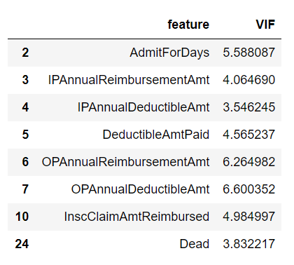
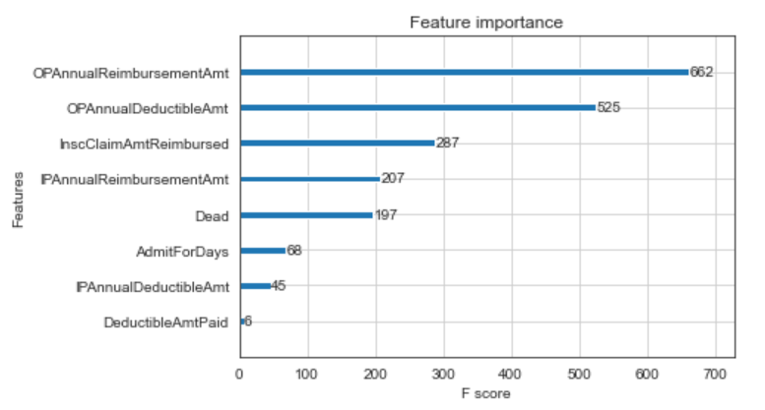
What variables can we use to determine a potentially fraud provider?
Through the VIF and Feature Importance analysis, we identified the 8 independent and important variables in determining potential fraud providers. The largest factors are Out of patient Reimbursement/Deductible Amounts for claims.

Slide 7
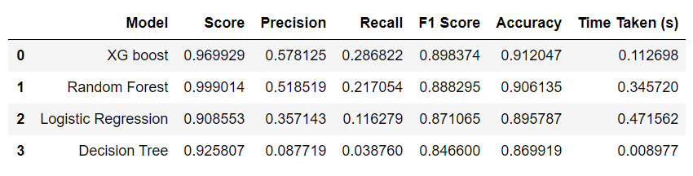
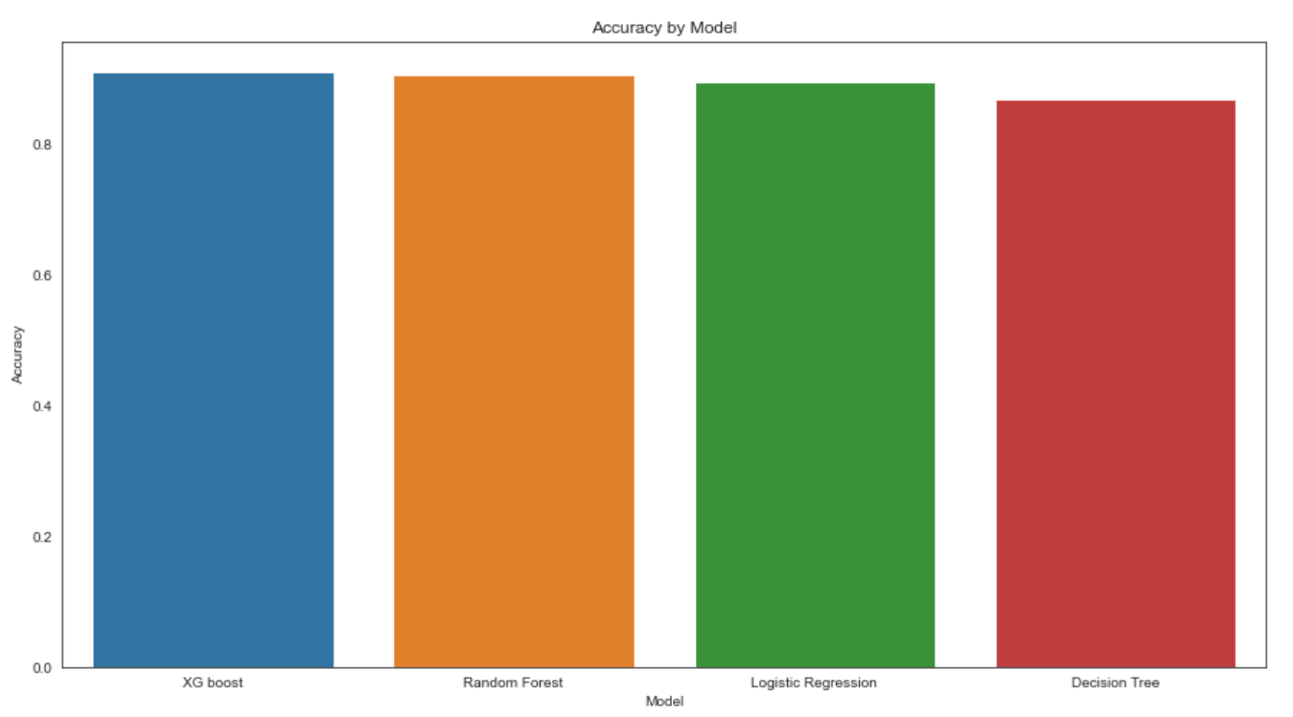
What Machine Learning model has the best accuracy for prediction?
Based on the analysis of multiple machine learning models with train and test datasets, XGBoost has the highest accuracy score (0.912), and therefore is the best predictive model for potential fraud providers.

Slide 8
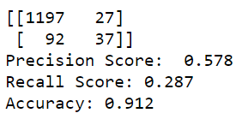
XGBoost Confusion Matrix
The XGBoost did have a 91% accuracy, it is always good practice to examine the details
1197 true positives and 37 true negatives out of 1353 test providers.
27 false positives and 92 false negatives
Precision is 0.578, so when the model predicts a false potential fraud provider, it is correct 57.8% of the time.
Recall is 0.287, so the model correctly identifies the 28.7% of all potential fraud providers

Slide 9
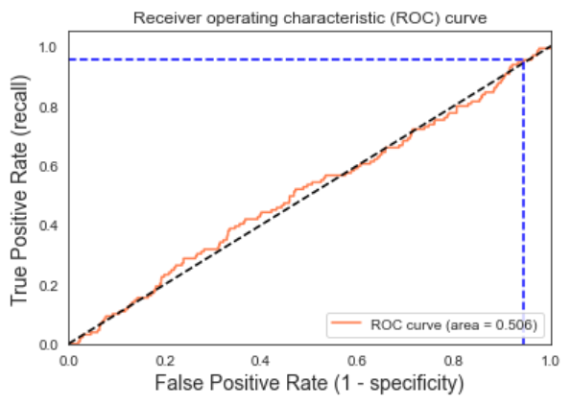
How successful is the data model?
After using the ROC curve, we can conclude that the data model is 50% accurate for incoming data.

Slide 10
Key conclusions
The most important variables for detecting potentially fraud providers are the following: Out of patient Reimbursement, Deductible Amounts, Insurance Amt Claimed.
XGBoost is the best prediction model of the Machine Learning models. High accuracy shouldn’t be used to assume that your model is successful. Precision, and Recall are important factors to consider.

Slide 11
Appendix

Slide 12
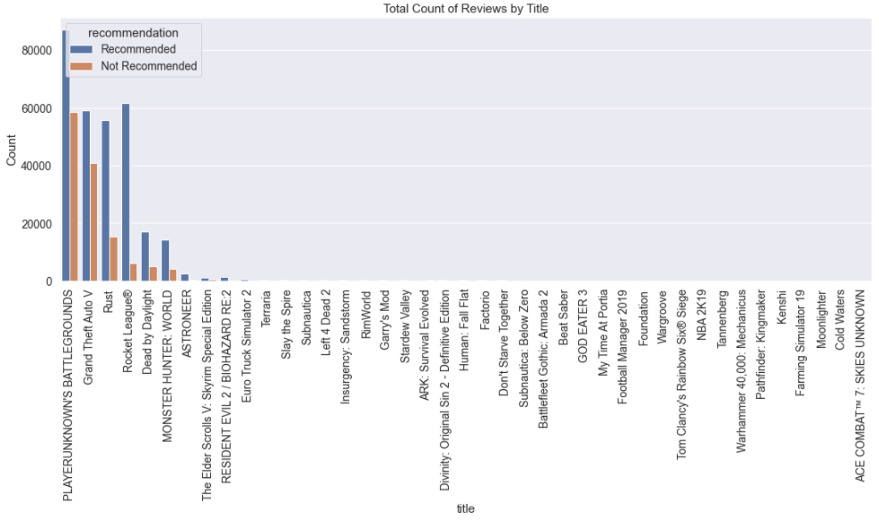
I. All Steam Reviews Sorted by Popularity

Slide 13
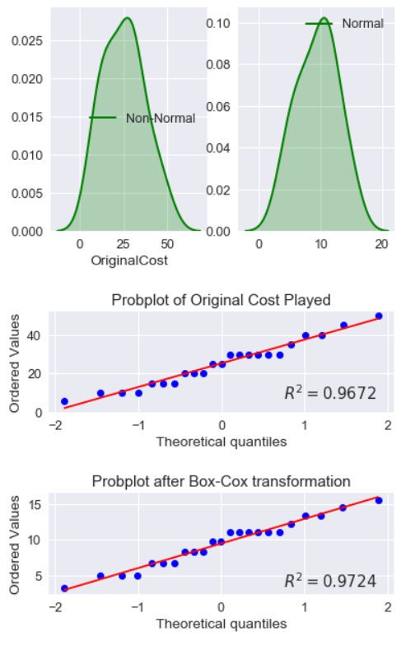
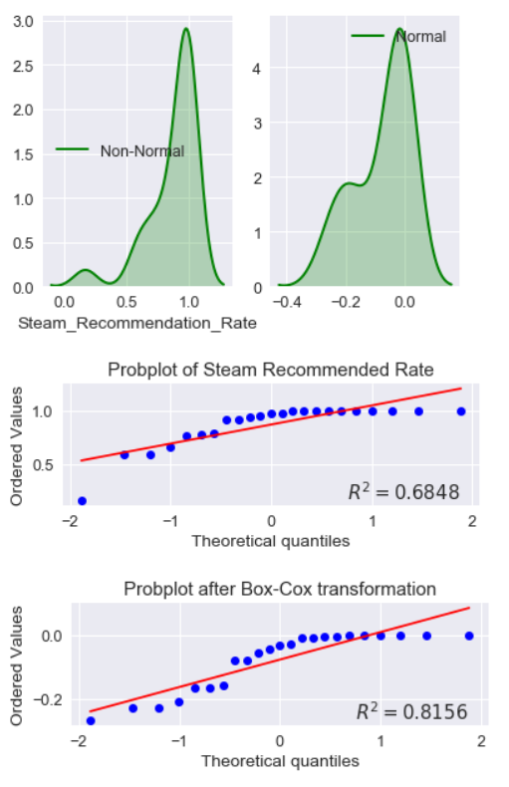
II. Probability Plots of Important Attributes
Original Cost
Steam Recommendation Rate
Original Cost follows a normal distribution.
Steam recommendation Rate is skewed to the left, so regression analysis uses the box cox transformed values.

Slide 14
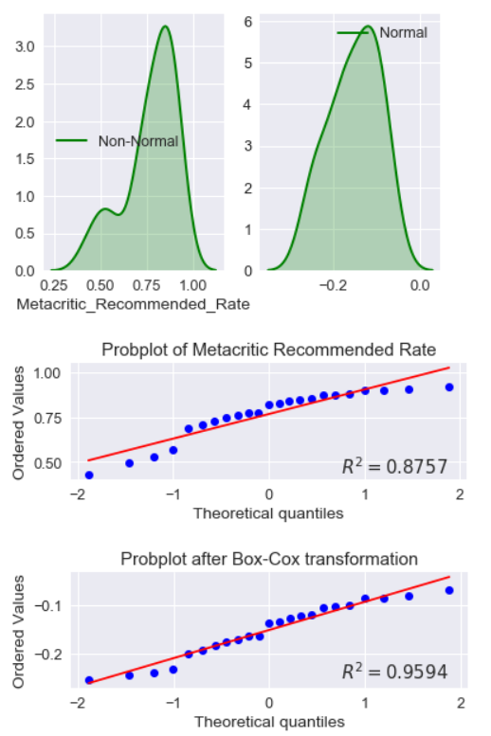
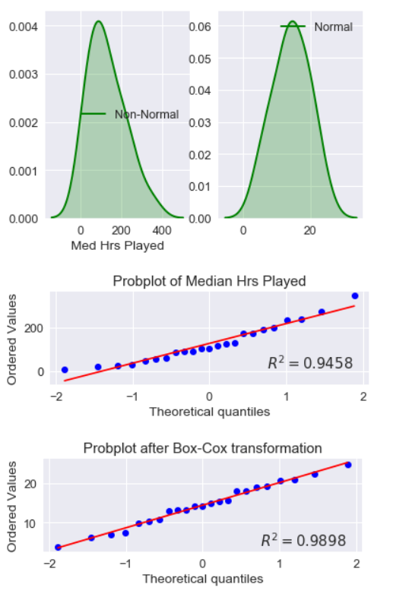
II. Probability Plots of Important Attributes
Metacritic Recommendation Rate
Median Hrs Played
Metacritic Recommendation Rate follows a normal distribution.
Median Hrs Played follows a normal distribution.

Slide 15
III. References
https://comparecamp.com/steam-statistics/#:~:text=Steam%20is%20the%20world's%20largest,year%20ever%20since%20its%20inception

